Slide 1


GoodCabs
"Driving Local Growth, Delivering Exceptional Service"
ad-hoc requirement – Business Problems

Slide 2

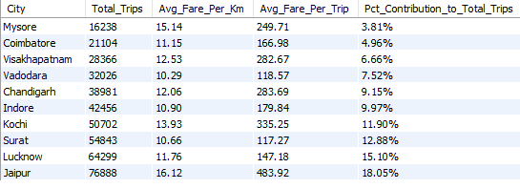
City Level Fare and Trip Summary Report

Slide 3
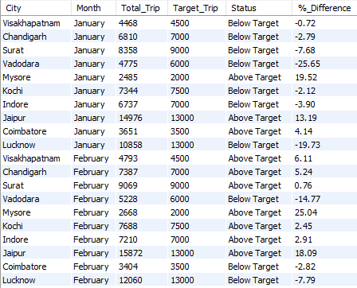
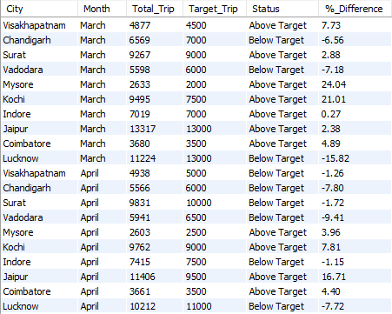
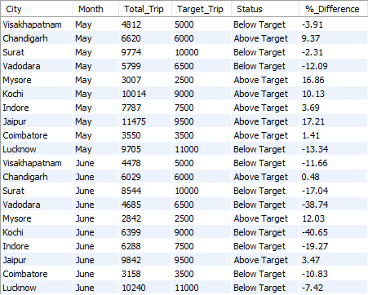
Monthly City - Level Trips Target Performance Report

Slide 4
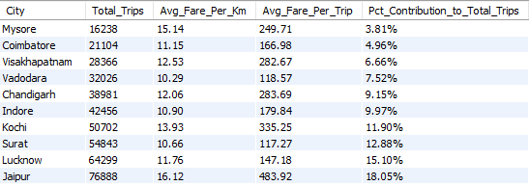
City-Level Repeat Passenger Trip Frequency Report

Slide 5
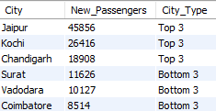
Identify the cities with Highest and Lowest Total New Passengers

Slide 6
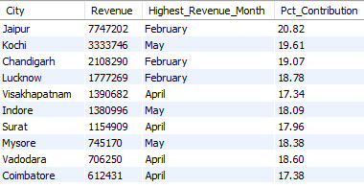
Identify the Month with Highest Revenue for ach city

Slide 7
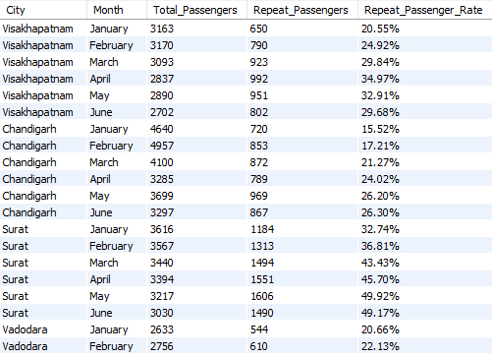
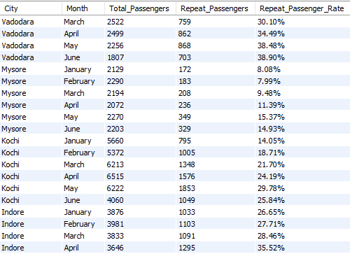
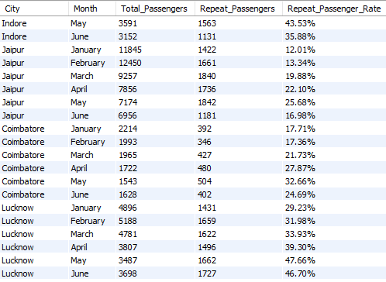
Repeat Passenger Rate Analysis - By City

Slide 8
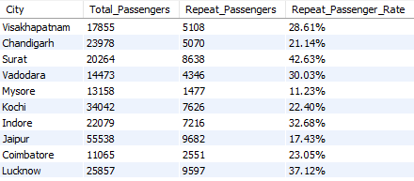
Repeat Passenger Rate Analysis - By Month

